Slide 1

Bapatla Engineering College Department of Information Technology Final Internal Review On Location Based Smart Crop Recommendation System BY Under The Esteemed Guidance Of Mrs . P . Surekha Assistant Professor Presented by M. S.V. Prasanna , Y22AIT470 N. Uday Kumar , Y22AIT481 N. Komali Kiran , Y22AIT483 A . V. Brahmam , Y22AIT403

Slide 2
CONTENTS
Abstract
Problem Statement
Literature Review
Domain Knowledge
Architecture and Methodology
Implementation
Conclusion
Future Scope

Slide 3
ABSTRACT
Agriculture plays a crucial role in the economy, and selecting the right crop based on environmental conditions is essential for maximizing productivity.This project proposes a location based smart crop recommendation system that uses machine learning techniques to suggest suitable crops for cultivation.The system takes inputs such as soil type, temperature, humidity, rainfall, and location data. These inputs are processed and analyzed using a trained machine learning model to predict the most suitable crop.The model is trained on agricultural datasets and provides accurate recommendations to assist farmers in making informed decisions.This system aims to improve crop yield, reduce risks, and promote efficient farming through data-driven insights.

Slide 4
PROBLEM STATEMENT
Traditional farming practices rely heavily on farmer experience and manual decision-making, which may not always lead to optimal crop selection.
Factors like soil condition, weather variations, and regional differences make crop selection complex.
To address this, the project proposes a smart recommendation system that uses environmental and location data to suggest the most suitable crop.
The goal is to provide a simple, fast, and accurate solution to help farmers improve productivity and reduce losses.

Slide 5
LITERATURE REVIEW
[1] “crop recommendation system using machine learning” (2023)
Provides crop suggestions based on soil and climate
Limitation: limited dataset and lower accuracy
Impact:
Highlights importance of ML in agriculture
Need for improved datasets and models
[2] “smart agriculture using iot and ML” (2022)
Combines iot sensors with ML models
Limitation: high cost and complex implementation
Impact:
Shows real-time capability but complexity issues
Our system focuses on simplicity and accessibility

Slide 6
DOMAIN KNOWLEDGE
Machine Learning Used to analyze agricultural data and predict suitable crops based on input parameters.
Python Programming language used for model development and implementation.
NumPy Used for numerical operations and handling dataset efficiently.
Pandas Used for data preprocessing and analysis.
Scikit-learn Used to implement machine learning algorithms like classification models.

Slide 7
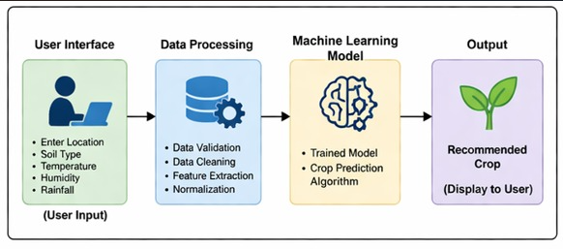
ARCHITECTURE

Slide 8
METHODOLOGY
Data Collection Collected agricultural data including soil type, temperature, humidity, and rainfall.
Data Preprocessing Cleaned dataset, handled missing values, normalized data.
Model Development Built ML model using classification algorithms.
Model Training Trained model using dataset for accurate prediction.
Model Evaluation Tested model accuracy and performance.
Deployment Integrated model into a system for user interaction.

Slide 9
SYSTEM REQUIREMENTS
Hardware requirements
Processor: intel i5 or higher
RAM: 8GB minimum
Storage: 256GB
Software requirements
Language: python
Tools: jupyter notebook / VS code
OS: windows

Slide 10
PROJECT IMPLEMENTATION
Crop suitability analysis module :
User enters a crop name
Backend fetches:
Temperature
Rainfall
Humidity
Soil type
Compares actual values vs required crop values

Slide 11
PROJECT IMPLEMENTATION
Determines suitable / not suitable status
Provides slide-by-slide reasons for each parameter
The user enters a crop name.
The system collects real-time weather data (temperature, rainfall, humidity) and soil information from datasets.
These values are compared with the crop’s required conditions to decide whether the crop is suitable or not.

Slide 12
CONCLUSION
This chapter presented the comprehensive implementation and rigorous evaluation of the web-based crop recommendation system, demonstrating its practical viability and significant impact on agricultural decision-making. The system successfully integrates real-time environmental data acquisition, hybrid artificial intelligence techniques, and location-based services to provide accurate, personalized crop recommendations for farmers . The implementation phase established a robust three-tier architecture comprising a responsive frontend interface, scalable restful API services, and efficient database systems. Key technical achievements include seamless gps-based location detection, open weather map API integration for live meteorological data, and optimized random forest models delivering 87.3% recommendation accuracy with 245ms median response time.

Slide 13
FUTURE SCOPE
Improve accuracy using larger datasets
Add real-time weather API integration
Develop mobile application
Multi-language support for farmers

Slide 14
Thank you

